Slide 1
Data and Data Collection
Fundamentally--2 types of data
Quantitative – Numbers, tests, counting, measuring
Qualitative – Words, images, observations, conversations, photographs

Slide 2
Data Collection Techniques
Observations,
Tests,
Surveys,
Document analysis
(the research literature)

Slide 3
Quantitative Methods
Experiment: Research situation with at least one independent variable, which is manipulated by the researcher

Slide 4
Independent Variable: The variable in the study under consideration. The cause for the outcome for the study.
Dependent Variable: The variable being affected by the independent variable. The effect of the study
y = f(x)
Which is which here?

Slide 5
Key Factors for High Quality Experimental Design
Data should not be contaminated by poor measurement or errors in procedure.
Eliminate confounding variables from study or minimize effects on variables.
Representativeness: Does your sample represent the population you are studying? Must use random sample techniques.

Slide 6
What Makes a Good Quantitative Research Design?
4 Key Elements
1. Freedom from Bias
2. Freedom from Confounding
3. Control of Extraneous Variables
4. Statistical Precision to Test Hypothesis

Slide 7
Bias: When observations favor some individuals in the population over others.
Confounding: When the effects of two or more variables cannot be separated.
Extraneous Variables: Any variable that has an effect on the dependent variable.
Need to identify and minimize these variables.
e.g., Erosion potential as a function of clay content. rainfall intensity, vegetation & duration would be considered extraneous variables.

Slide 8
Precision versus accuracy
"Precise" means sharply defined or measured.
"Accurate" means truthful or correct.

Slide 9
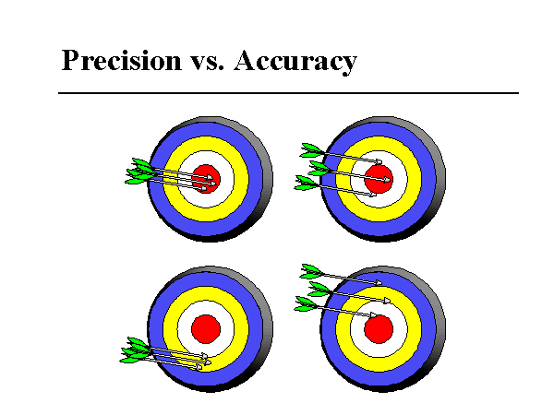
Both Accurate
and Precise
Accurate
Not precise
Not accurate
But precise
Neither accurate
nor precise

Slide 10
Interpreting Results of Experiments
Goal of research is to draw conclusions. What did the study mean?
What, if any, is the cause and effect of the outcome?

Slide 11
Introduction to Sampling
Sampling is the problem of accurately acquiring the necessary data in order to form a representative view of the problem.
This is much more difficult to do than is generally realized.

Slide 12
Overall Methodology:
* State the objectives of the survey
* Define the target population
* Define the data to be collected
* Define the variables to be determined
* Define the required precision & accuracy
* Define the measurement `instrument'
* Define the sample size & sampling method, then select the sample

Slide 13
Sampling
Distributions:
When you form a sample you often show it by a plotted distribution known as a histogram .
A histogram is the distribution of frequency of occurrence of a certain variable within a specified range.
NOT A BAR GRAPH WHICH LOOKS VERY SIMILAR

Slide 14
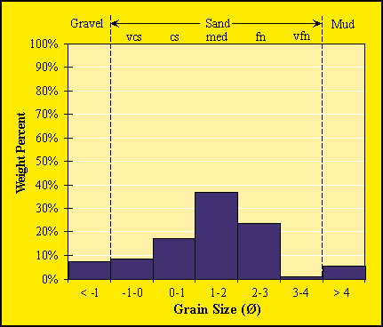

Slide 15
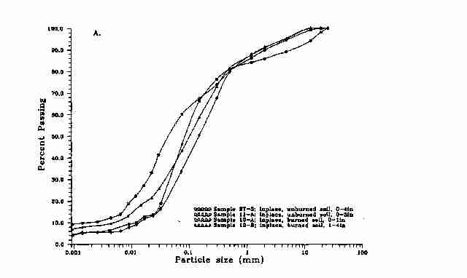

Slide 16
Interpreting quantitative findings
Descriptive Statistics : Mean, median, mode, frequencies
Error analyses

Slide 17
Mean
In science the term mean is really the arithmetic mean
Given by the equation
X = ¹/_{n} Σ x_{i}
n
i=1
Or more simply put, the sum of values divided by the number of values summed

Slide 18
Median
Consider the set
1, 1, 2, 2, 3, 6, 7, 11, 11, 13, 14, 16, 19
  In this case there are 13 values so the median is the middle value, or (n+1) / 2
  (13+1) /2 = 7
Consider the set
1, 1, 2, 2, 3, 6, 7, 11, 11, 13, 14, 16
  In the second case, the mean of the two middle values is the median or (n+1) /2
(12 + 1) / 2 = 6.5 ~ (6+7) / 2 = 6.5
Or more simply put the mid value separating all values in the upper 1/2 of the values from those in the lower half of the values

Slide 19
Mode
The most frequent value in a data set
Consider the set
1, 1, 1, 1, 2, 2, 3, 6, 11, 11, 11, 13, 14, 16, 19
  In this case the mode is 1 because it is the most common value
There may be cases where there are more than one mode as in this case
Consider the set
1, 1, 1, 1, 2, 2, 3, 6, 11, 11, 11, 11, 13, 14, 16, 19
  In this case there are two modes (bimodal) : 1 and 11 because both occur 4 times in the data set.

